Slide 1

Discrete Mathematics
Do U ever guess?
Creativity – Lesson 1
April 28th, 2017

Slide 2
In real life, do U solve problems?
How?
Do you try to GUESS and find ways to solve the problem?
How do you check whether your guess works?
If not, what do you do?
Do you try again?
Would you call this CREATIVITY?

Slide 3

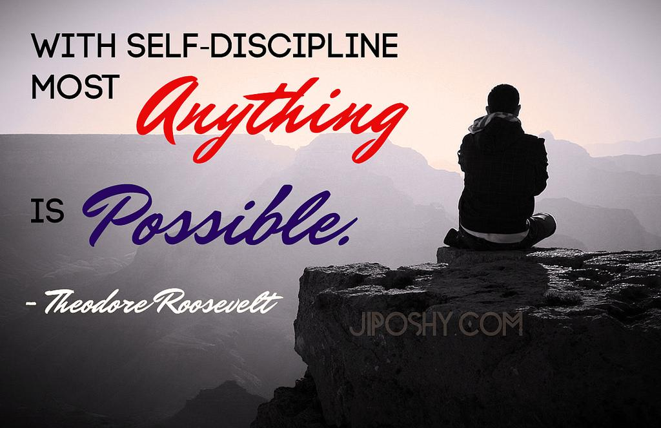

Slide 4
As a student, what do U do?
Do U like to memorise and get the answer right to get marks?
Or do U like to Guess & Check Ur answer?

Slide 5
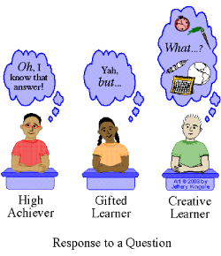
Which student do you think would succeed in real life? Why?

Slide 6
Pair up, discuss the 3 students.
As an Engineering student, which type of student do U
want to be? Why?

Slide 7
Write all ideas on the board.
Can we start to be
CREATIVE
from today?

Slide 8
Are U willing to accept challenge?

Slide 9
Idea cards:
What would you like to learn in this course?
Pair up, discuss with your partner
On VIPP cards write your ideas using keywords or phrases –
ONE idea per card

Slide 10
Group ideas on cards:
What are the 5 main things
U wish to learn?
Write FIVE main titles below:
1. 2.
3. 4. 5.

Slide 11
Group Presentations
Class to break up into five groups.
Each group to take ONE title and decide how they would like to learn.
Write their answers in keywords on poster.
Then compare their answer with ONE course objective given.

Slide 12
Course Objectives 1
1. Mathematical Reasoning: Students must be able to construct mathematical arguments and formulae from mathematical reasoning and logic.

Slide 13
Course Objective 2
2. Combinatorial Analysis: Develop problem-solving skills using the ability to count or enumerate objects.

Slide 14
Course Objective 3
3. Discrete Structures: Students should be able to work with discrete structures. These discrete structures include sets, permutations, relations, graphs, trees, and finite-state machines

Slide 15
Course Objective 4
Algorithmic Thinking: Students should be able to develop algorithms to deal with discrete structures.

Slide 16
Course Objective 5
5. Applications and Modeling: Students should be able to apply discrete structures to applications in Computer Science.

Slide 17
Buy book Read contents and guess what might each chapter contain and summarize using a diagram.
Discrete Mathematics and Its Applications By Kenneth H. Rosen
7th Edition

